Slide 1
Java Exception Handling

Slide 2
Exception Handling
The exception handling in java is one of the powerful mechanism to handle the runtime errors so that normal flow of the application can be maintained.
Simply handling the abnormal termination of the program.

Slide 3
What is exception?
Dictionary Meaning: Exception is an abnormal condition.
Exception is a Runtime error (or)
Exception is abnormal termination of the program
In java, exception is an event that disrupts the normal flow of the program. It is an object which is thrown at runtime.
When Exception occurs, JVM creates the Exception object and throw it.

Slide 4
What is Exception Handling?
Exception Handling is a mechanism to handle runtime errors such as
ClassNotFoundException,
IOException,
SQLException,
ArithmeticException,
NullPointerException etc.

Slide 5
Exception Handling
statement 1;
statement 2;
statement 3;
statement 4;
statement 5;//exception occurs
statement 6;
statement 7;
statement 8;
statement 9;
statement 10;
Suppose there is 10 statements in your program and there occurs an exception at statement 5, rest of the code will not be executed i.e. statement 6 to 10 will not run. If we perform exception handling, rest of the statement will be executed. That is why we use exception handling in java.

Slide 6
Example
public class Test {
public static void main(String[] args) {
System.out.println("statement 1");
System.out.println("statement 2");
System.out.println("statement 3");
System.out.println("statement 4");
System.out.println("statement 5");
try {
int d = 10/0;
} catch (Exception e) {
System.err.println("Divided by zero calculation is not possible..");
}
System.out.println("statement 6");
System.out.println("statement 7");
System.out.println("statement 8");
System.out.println("statement 9");
System.out.println("statement 10");
} }

Slide 7
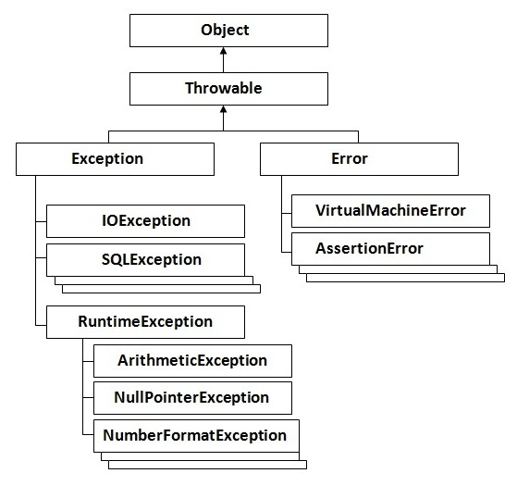
Hierarchy of Java Exception classes

Slide 8
Types of Exception
Checked Exception
Unchecked Exception
The classes that extend Exception class except RuntimeException are known as checked exceptions e.g.IOException, SQLException etc. Checked exceptions are checked at compile-time.
The classes that extend RuntimeException are known as unchecked exceptions e.g. ArithmeticException, NullPointerException, ArrayIndexOutOfBoundsException etc. Unchecked exceptions are not checked at compile-time rather they are checked at runtime.

Slide 9
Error?
Error is irrecoverable
e.g. OutOfMemoryError,
VirtualMachineError,
AssertionError etc.

Slide 10
Common scenarios where exceptions may occur

Slide 11
1) Scenario where ArithmeticException occurs
If we divide any number by zero, there occurs an ArithmeticException.
int a=50/0;//ArithmeticException

Slide 12
2) Scenario where NullPointerException occurs
If we have null value in any variable, performing any operation by the variable occurs an NullPointerException.
String s=null;
System.out.println(s.length());//NullPointerException

Slide 13
3) Scenario where NumberFormatException occurs
The wrong formatting of any value, may occur NumberFormatException. Suppose I have a string variable that have characters, converting this variable into digit will occur NumberFormatException.
String s="abc";
int i=Integer.parseInt(s);//NumberFormatException

Slide 14
Example:
import java.util.Scanner;
public class NumberFormatExceptionEx {
public static void main(String[] args) {
Scanner scanner = new Scanner(System.in);
System.out.println("Enter your age");
int inputAge = scanner.nextInt();
try {
if(inputAge<18){
System.out.println("not eligible for vote");
}else{
System.out.println("eligible");
}
} catch (NumberFormatException e) {
System.err.println("Please enter only numbers");
}}}

Slide 15
4) Scenario where ArrayIndexOutOfBoundsException occurs
int a[]=new int[5];
a[10]=50; //ArrayIndexOutOfBoundsException

Slide 16
Java Exception Handling Keywords
try
catch
finally
throw
throws

Slide 17
try-catch block

Slide 18
try block
Java try block is used to enclose the code that might throw an exception. It must be used within the method.
Java try block must be followed by either catch or finally block.

Slide 19
Syntax of java try-catch
try{
//code that may throw exception
}catch(Exception_class_Name ref){
}

Slide 20
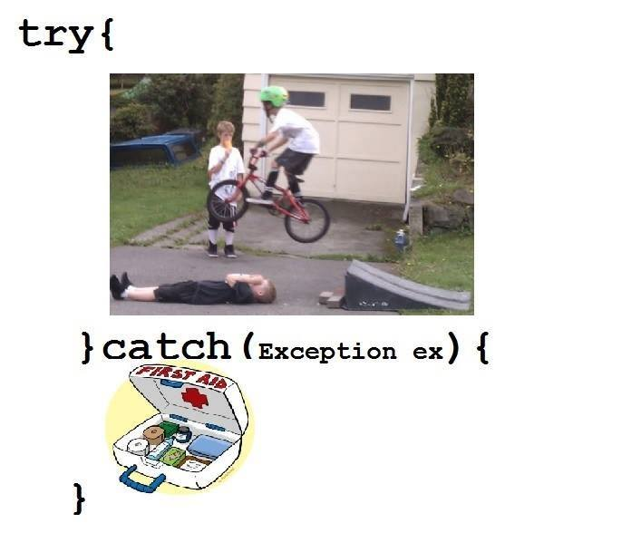

Slide 21
Syntax of try-finally block
try{
//code that may throw exception
}finally{}

Slide 22
Java catch block
Java catch block is used to handle the Exception. It must be used after the try block only.
You can use multiple catch block with a single try.

Slide 23
Problem without exception handling
public class Testtrycatch1{
public static void main(String args[]){
int data=50/0;//may throw exception
System.out.println("rest of the code...");
}
}

Slide 24
output
Exception in thread main java.lang.ArithmeticException:/ by zero

Slide 25
Solution by exception handling
public class Testtrycatch2{
public static void main(String args[]){
try{
int data=50/0;
}catch(ArithmeticException e){System.out.println(e);}
System.out.println("rest of the code...");
}
}

Slide 26
output
Exception in thread main java.lang.ArithmeticException:/ by zero
rest of the code...

Slide 27
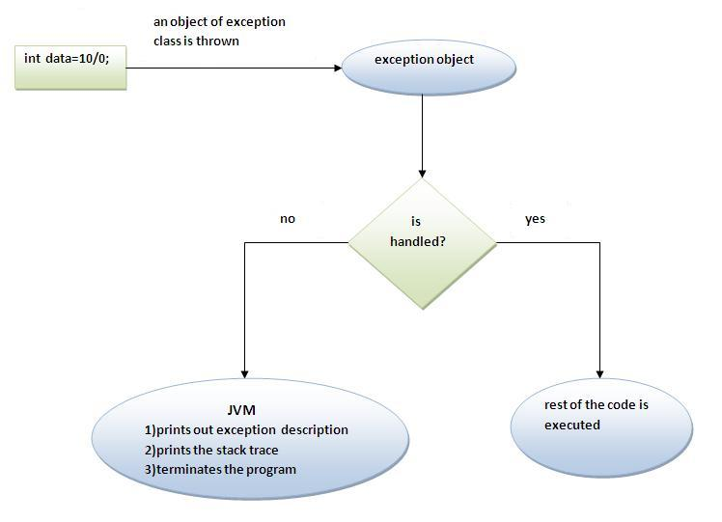
Internal working of java try-catch block

Slide 28
Multi catch block
If you have to perform different tasks at the occurrence of different Exceptions, use java multi catch block.

Slide 29
Example
public class TestMultipleCatchBlock{
public static void main(String args[]){
try{
int a[]=new int[5];
a[5]=30/0;
}
catch(ArithmeticException e){System.out.println("task1 is completed");}
catch(ArrayIndexOutOfBoundsException e){System.out.println("task 2 completed");}
catch(Exception e){System.out.println("common task completed");}
System.out.println("rest of the code...");
}
}

Slide 30
Notes
At a time only one Exception is occurred and at a time only one catch block is executed.
All catch blocks must be ordered from most specific to most general i.e. catch for ArithmeticException must come before catch for Exception .

Slide 31
Nested try block
The try block within a try block is known as nested try block in java.

Slide 32
Syntax:
....
try
{
statement 1;
statement 2;
try
{
statement 1;
statement 2;
}
catch(Exception e)
{
}
}
catch(Exception e)
{
}
....

Slide 33
finally block

Slide 34
finally block
Java finally block is a block that is used to execute important code such as closing connection, stream etc.
Java finally block is always executed whether exception is handled or not.
Java finally block must be followed by try or catch block.

Slide 35
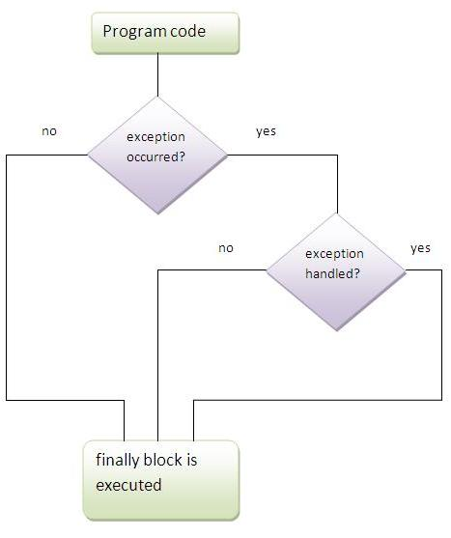
finally block

Slide 36
Note
If you don't handle exception, before terminating the program, JVM executes finally block(if any).

Slide 37
Why use java finally
Finally block in java can be used to put "cleanup" code such as closing a file, closing connection etc.

Slide 38
Usage of Java finally Case 1 : When exception doesn’t occur
class TestFinallyBlock{
public static void main(String args[]){
try{
int data=25/5;
System.out.println(data);
}
catch(NullPointerException e){System.out.println(e);}
finally{System.out.println("finally block is always executed");}
System.out.println("rest of the code...");
}
}

Slide 39
Usage of Java finally Case 2 : When exception occurs and not handled
class TestFinallyBlock1{
public static void main(String args[]){
try{
int data=25/0;
System.out.println(data);
}
catch(NullPointerException e){System.out.println(e);}
finally{System.out.println("finally block is always executed");}
System.out.println("rest of the code...");
}
}

Slide 40
Usage of Java finally Case 3: When exception occurs and handled
public class TestFinallyBlock2{
public static void main(String args[]){
try{
int data=25/0;
System.out.println(data);
}
catch(ArithmeticException e){System.out.println(e);}
finally{System.out.println("finally block is always executed");}
System.out.println("rest of the code...");
}
}

Slide 41
Notes
For each try block there can be zero or more catch blocks, but only one finally block.
The finally block will not be executed if program exits(either by calling System.exit() or by causing a fatal error that causes the process to abort).

Slide 42
***Guess the output
public class TryFinally {
public static void main(String[] args) {
try {
System.out.println("try block");
System.exit(0);
} finally {
System.out.println("Finally block");
}
}
}

Slide 43
Output
try block

Slide 44
throw keyword

Slide 45
throw keyword
The Java throw keyword is used to explicitly throw an exception.
We can throw either checked or uncheked exception in java by throw keyword. The throw keyword is mainly used to throw custom exception. We will see custom exceptions later.
Syntax:
throw exception;
Ex: throw new IOException("sorry device error);

Slide 46
throw keyword example
In this example, Create validate method that takes integer value as a parameter. If the age is less than 18, throw the ArithmeticException otherwise print a message welcome to vote

Slide 47
throw keyword example
public class TestThrow1{
static void validate(int age){
if(age<18)
throw new ArithmeticException("not valid");
else
System.out.println("welcome to vote");
}
public static void main(String args[]){
validate(13);
System.out.println("rest of the code...");
}
}

Slide 48
Custom/User defined Exception

Slide 49
Custom Exception
If you are creating your own Exception that is known as custom exception or user-defined exception. Java custom exceptions are used to customize the exception according to user need.
By the help of custom exception, you can have your own exception and message.

Slide 50
InvalidAgeException Class
class InvalidAgeException extends Exception{
InvalidAgeException(String s){
super(s);
}
}

Slide 51
TestCustomException1
class TestCustomException1{
static void validate(int age)throws InvalidAgeException{
if(age<18)
throw new InvalidAgeException("not valid");
else
System.out.println("welcome to vote");
}
public static void main(String args[]){
try{
validate(13);
}catch(Exception m){System.out.println("Exception occured: "+m);}
System.out.println("rest of the code...");
}
}

Slide 52
Output
Exception occurred: InvalidAgeException: not valid

Slide 53
throws Keyword
The Java throws keyword is used to declare an exception. It gives an information to the programmer that there may occur an exception so it is better for the programmer to provide the exception handling code so that normal flow can be maintained.
Exception Handling is mainly used to handle the checked exceptions. If there occurs any unchecked exception such as NullPointerException, it is programmers fault that he is not performing check up before the code being used.

Slide 54
Syntax of java throws
return_type method_name() throws exception_class_name{
//method code
}

Slide 55
Which exception should be declared
checked exception only, because:
unchecked Exception: under your control so correct your code.
error: beyond your control e.g. you are unable to do anything if there occurs VirtualMachineError or StackOverflowError.

Slide 56
Advantage of Java throws keyword
It provides information to the caller of the method about the exception.

Slide 57
Java throws example
class Testthrows1{
void m()throws IOException{
throw new IOException("device error");//checked exception
}
public static void main(String args[]) throws IOException{
Testthrows1 obj=new Testthrows1();
obj.m();
System.out.println("normal flow...");
}
}

Slide 58
output
Exception handled
Normal flow…

Slide 59
Difference between throw and throws in Java
No. | throw | throws
1) | Java throw keyword is used to explicitly throw an exception. | Java throws keyword is used to declare an exception.
3) | Throw is followed by an instance. Ex: throw new ArithmeticException(); | Throws is followed by class. Ex: throws Exception
4) | Throw is used within the method. | Throws is used with the method signature.
5) | You cannot throw multiple exceptions. | You can declare multiple exceptions e.g. public void method()throws IOException,SQLException.

Slide 60
Difference between throw and throws
Java throw example
void m(){
throw new ArithmeticException("sorry");
}
Java throws example
void m()throws ArithmeticException{
//method code
}

Slide 61
Java throw and throws example
void m()throws ArithmeticException{
throw new ArithmeticException("sorry");
}

Slide 62
What are differences among throw, throws and thrown?
Thrown is invalid

Slide 63
Difference between final, finally and finalize
No. | final | finally | finalize
1) | Final is used to apply restrictions on class, method and variable. Final class can't be inherited, final method can't be overridden and final variable value can't be changed. | Finally is used to place important code, it will be executed whether exception is handled or not. | Finalize is used to perform clean up processing just before object is garbage collected.
2) | final is a keyword. | finally is a block. | finalize is a method.

Slide 64
final example
class FinalExample{
public static void main(String[] args){
final int x=100;
x=200;//Compile Time Error
}}

Slide 65
finally example
class FinallyExample{
public static void main(String[] args){
try{
int x=300;
}catch(Exception e){System.out.println(e);}
finally{System.out.println("finally block is executed");}
}}

Slide 66
finalize example
class FinalizeExample{
public void finalize(){System.out.println("finalize called");}
public static void main(String[] args){
FinalizeExample f1=new FinalizeExample();
FinalizeExample f2=new FinalizeExample();
f1=null;
f2=null;
System.gc();
}}

